Slide 1
Graph Traversal (cont)
COMP9312_22T2

Slide 2
Minimum spanning tree

Slide 3
Minimum Spanning Tree
In this topic, we will
Define a spanning tree
Define the weight of a spanning tree in a weighted graph
Define a minimum spanning tree
Applications
Solutions
Given 5 vertices, how many undirected edges are needed at least to connect these vertices together?
Given n vertices, how many undirected edges are needed at least to connect these vertices together?

Slide 4
Minimum Spanning Tree
In this topic, we will
Define a spanning tree
Define the weight of a spanning tree in a weighted graph
Define a minimum spanning tree
Applications
Solutions
Given 5 vertices, how many undirected edges are needed at least to connect these vertices together?
4
Given n vertices, how many undirected edges are needed at least to connect these vertices together?
n-1

Slide 5
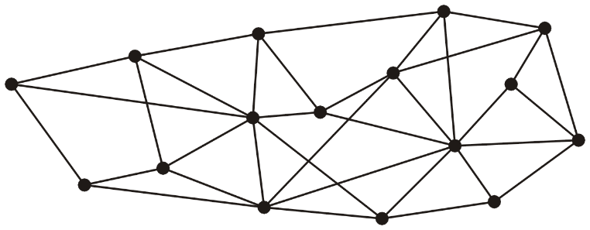
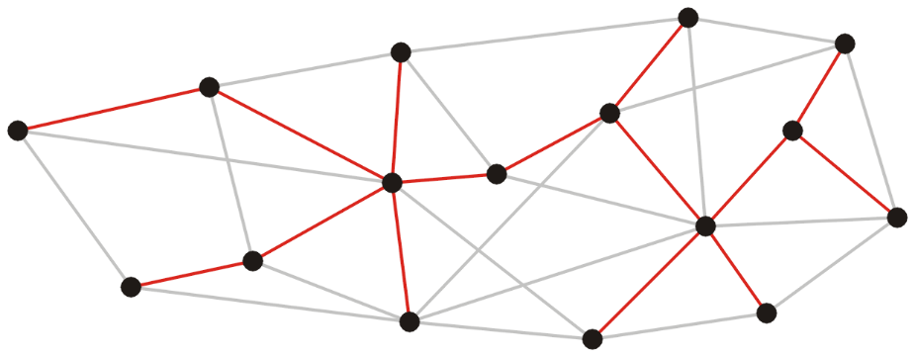
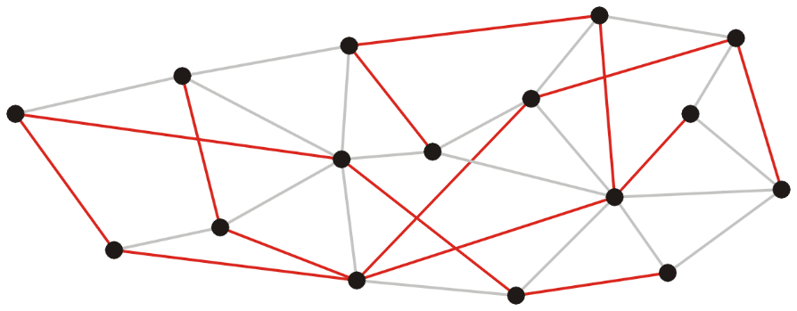
Spanning trees
Given a connected graph with n vertices, a spanning tree is defined a collection of n – 1 edges which connect all n vertices.
The n vertices and n – 1 edges define a connected sub-graph.
A spanning tree is not necessarily unique.
Notes:
A graph with 16 vertices and 35 edges and its two minimum spanning trees.

Slide 6
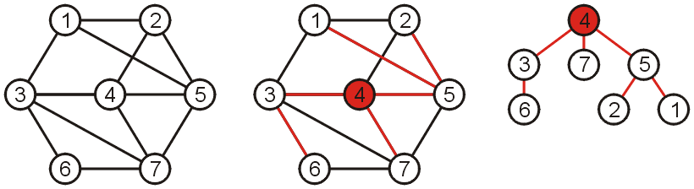
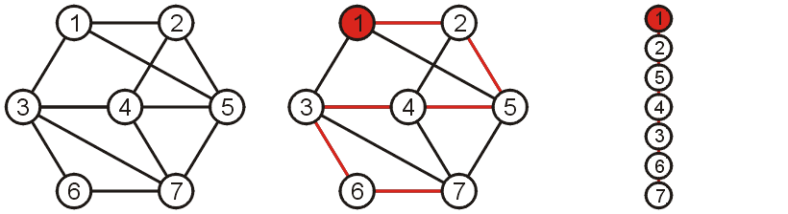
Spanning trees
Such a collection of edges is called a tree because if any vertex is taken to be the root, we form a tree by treating the adjacent vertices as children.
Notes:
What if we take 1 as the root?

Slide 7

Spanning trees on weighted graphs
The weight of a spanning tree is the sum of the weights on all the edges which comprise the spanning tree
The weight of the above spanning tree is 20
The weight of the above spanning tree is 28
Notes:
The weight of first spanning tree is 20
The weight of second spanning tree is 28

Slide 8
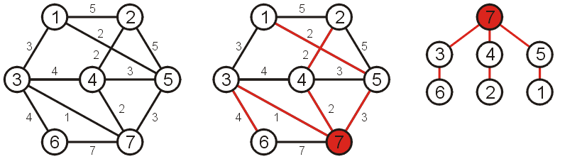
Minimum Spanning Trees
Which spanning tree which minimizes the weight?
Such a tree is termed a minimum spanning tree
The weight of this spanning tree is 14

Slide 9
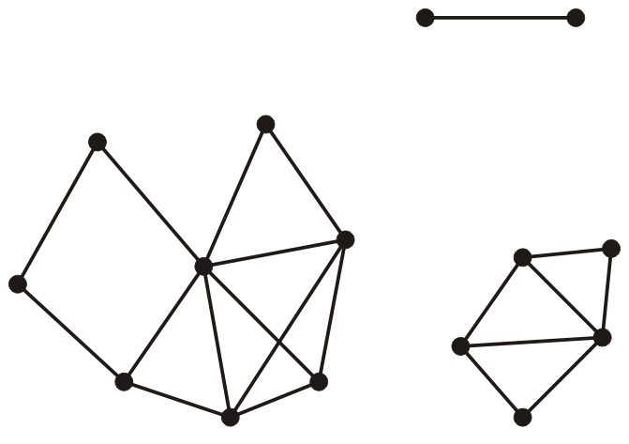
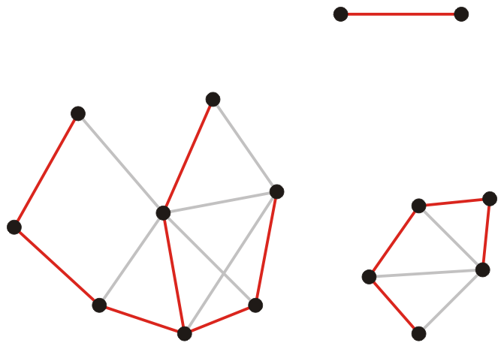
Spanning forests
Suppose that a graph is composed of N connected vertex-induced sub-graphs
In this case, we may define a spanning forest as a collection of N spanning trees, one for each connected vertex-induced sub-graph
A minimum spanning forest is therefore a collection of N minimum spanning trees, one for each connected vertex-induced sub-graph
Notes:
A forest is a collection of trees.
Observation
In an unweighted graph, we nominally give each edge a weight of 1
Consequently, all minimum spanning trees have weight |V| – 1

Slide 10
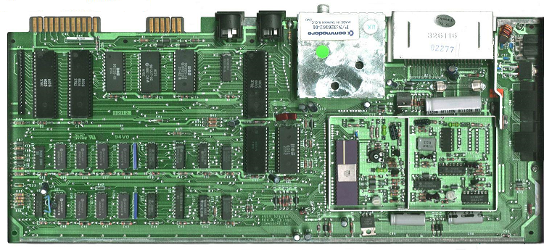

Application
Consider supplying power to
All circuit elements on a board
A number of loads within a building
A minimum spanning tree will give the lowest-cost solution
www.kpmb.com
www.commedore.ca

Slide 11
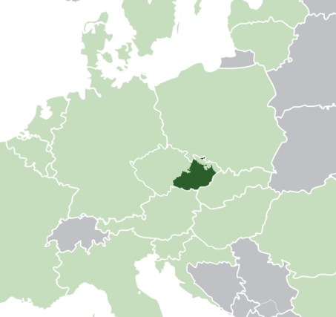
Application
The first application of a minimum spanning tree algorithm was by the Czech mathematician Otakar Borůvka who designed electricity grid in Morovia in 1926
www.kpmb.com
www.commedore.ca

Slide 12
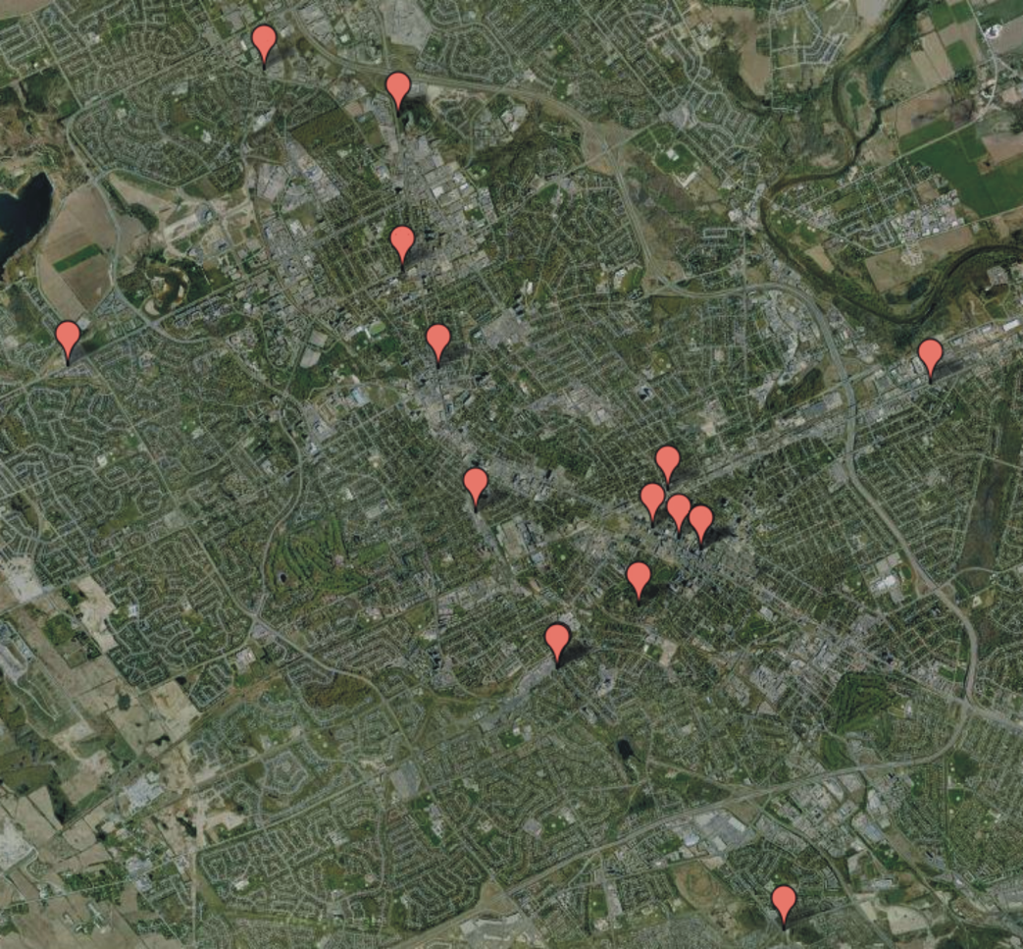
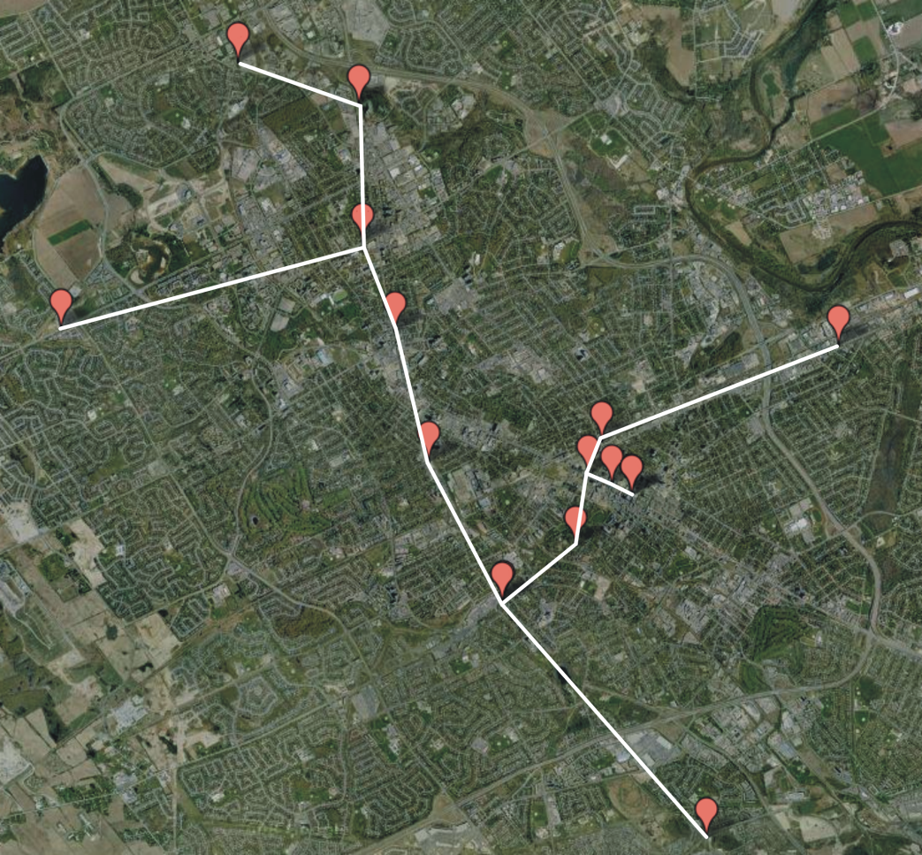
Application
Consider attempting to find the best means of connecting a number of LANs
Minimize the number of bridges
Costs not strictly dependant on distances

Slide 13
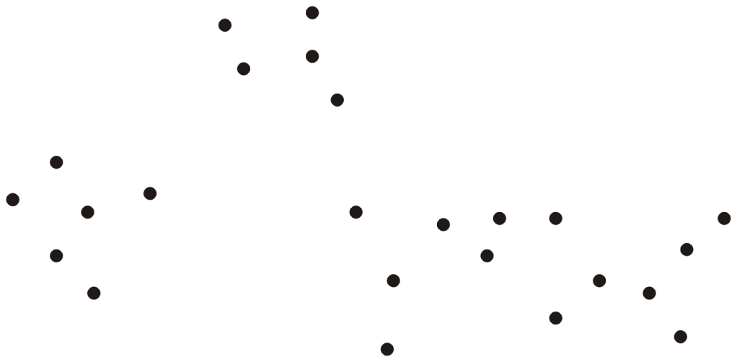
Application
Consider an ad hoc wireless network
Any two terminals can connect with any others
Problem:
Errors in transmission increase with transmission length
Can we find clusters of terminals which can communicate safely?

Slide 14
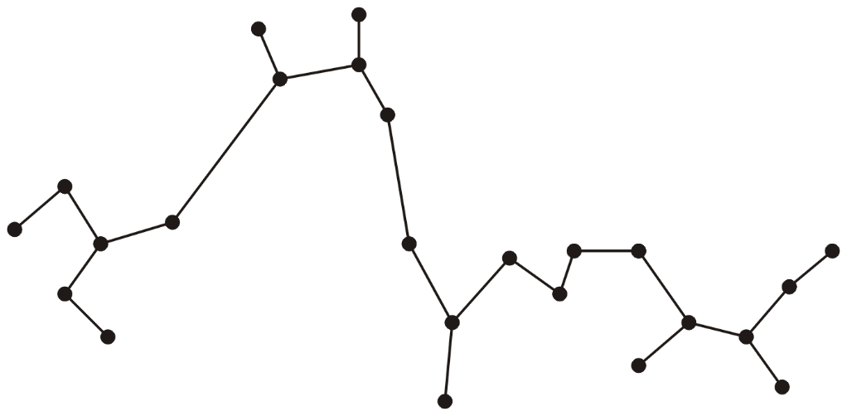
Application
Find a minimum spanning tree

Slide 15
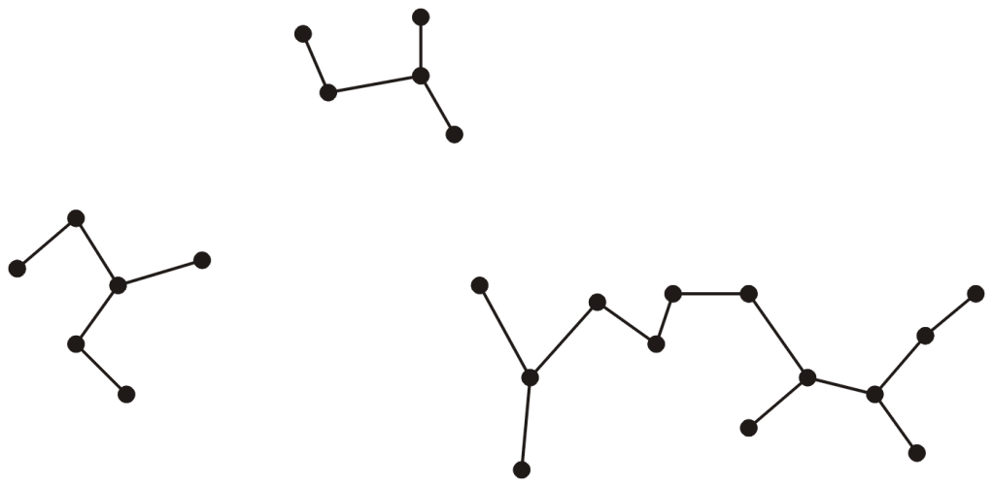
Application
Remove connections which are too long
This clusters terminals into smaller and more manageable sub-networks

Slide 16
Prim’s Algorithm

Slide 17
Algorithms for finding MST
Prim’s algorithm for finding the minimum spanning tree states:
Start with an arbitrary vertex to form a minimum spanning tree on one vertex
At each step, add that vertex v not yet in the minimum spanning tree that has an edge with least weight that connects v to the existing minimum spanning sub-tree
Continue until we have n – 1 edges and n vertices

Slide 18
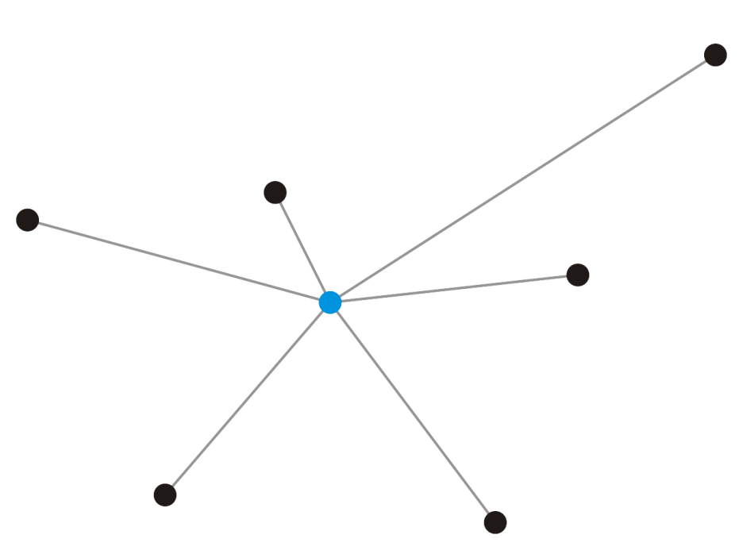
Motivation for Prim’s algorithm
Suppose we take a vertex
Given a single vertex e₁, it forms a minimum spanning tree on one vertex
v₁

Slide 19
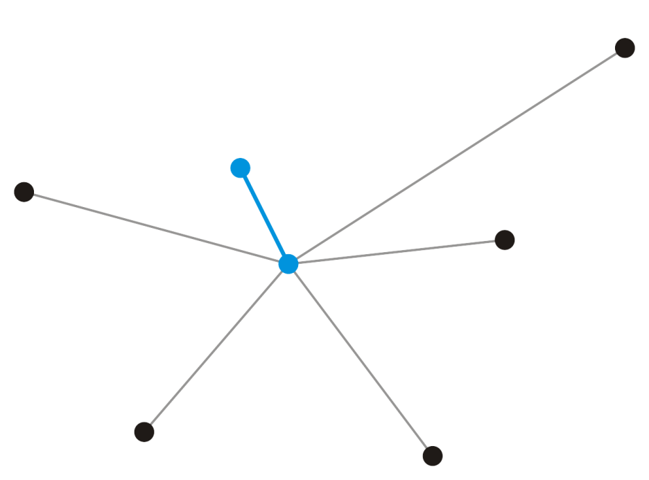
Motivation for Prim’s algorithm
Add that adjacent vertex v₂ that has a connecting edge e₁ of minimum weight
This forms a minimum spanning tree on our two vertices and e₁ must be in any minimum spanning tree containing the vertices v₁ and v₂
v₂
e₁
v₁

Slide 20
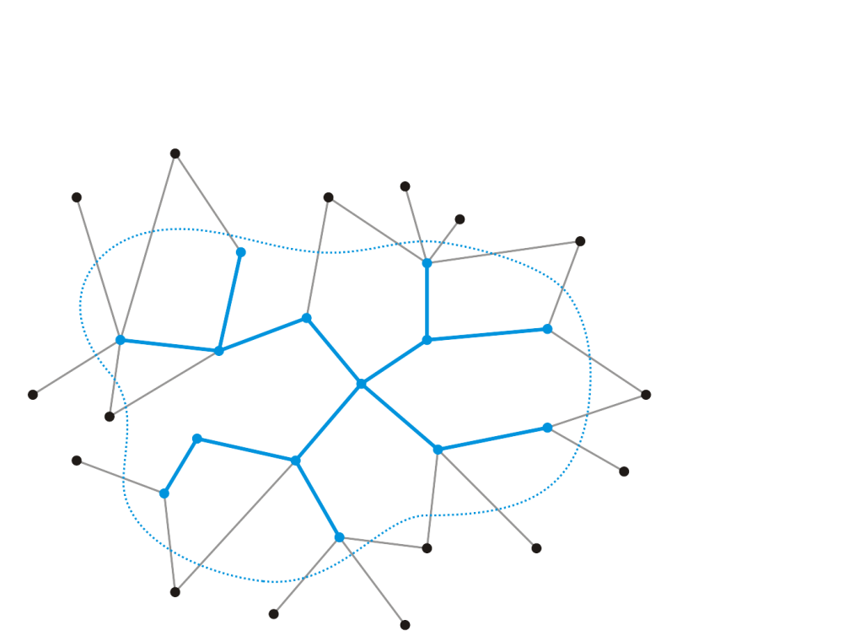
Motivation for Prim’s algorithm
Strategy:
Suppose we have a known minimum spanning tree on k < n vertices
How could we extend this minimum spanning tree?

Slide 21

Motivation for Prim’s algorithm
Add that edge e_{k} with least weight that connects this minimum spanning tree to a new vertex v_{k + 1}
This does create a minimum spanning tree on k + 1 nodes—there is no other edge we could add that would connect this vertex
Does the new edge, however, belong to the minimum spanning tree on all n vertices?
Yes
v_{k + 1}
e_{k}
Notes:
It turns out that we can maintain this MST greedily and still get an optimal solution.

Slide 22
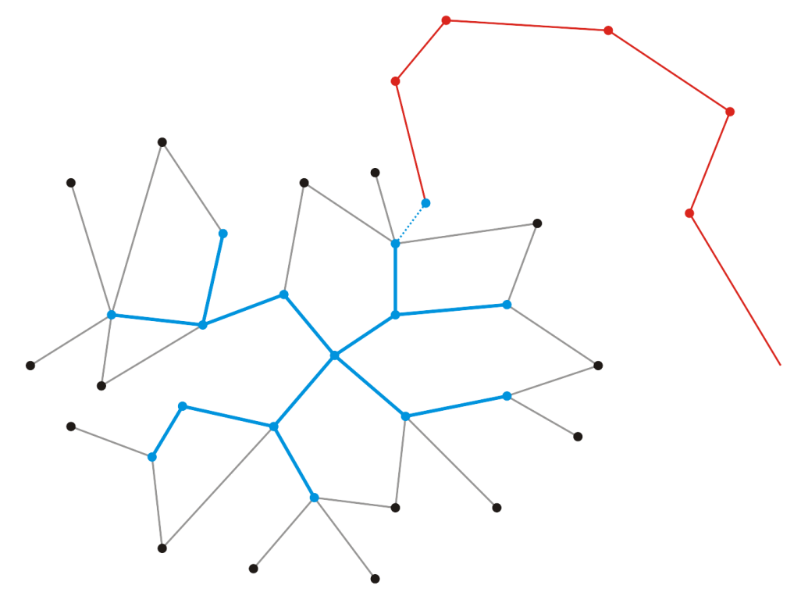
Motivation for Prim’s algorithm
Proof: Suppose it does not
Thus, vertex v_{k + 1} is connected to the minimum spanning tree via another sequence of edges
v_{k + 1}
e_{k}

Slide 23
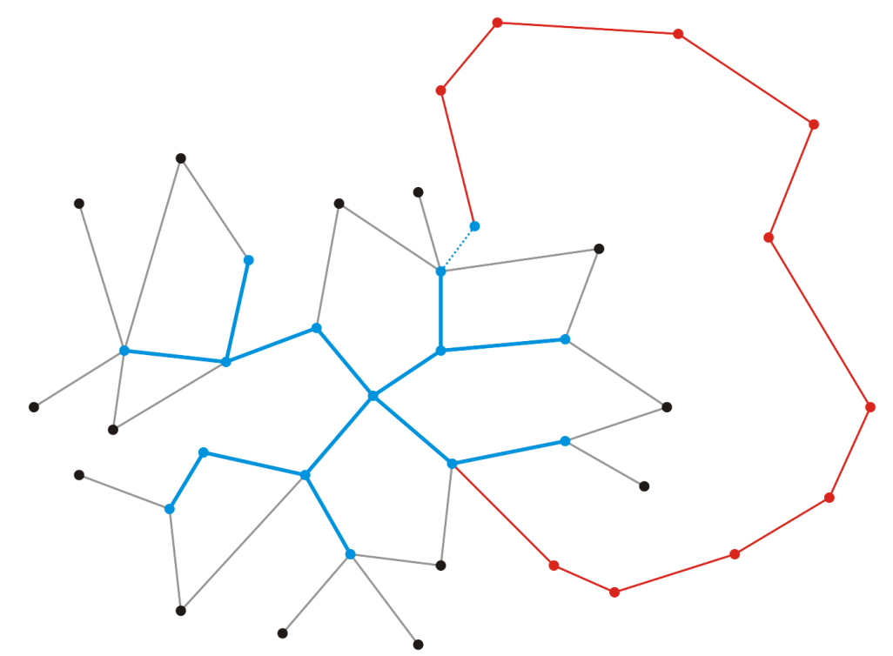
Motivation for Prim’s algorithm
Proof: Because a minimum spanning tree is connected, there must be a path from vertex v_{k + 1} back to our existing minimum spanning tree
It must be connected along some edge
v_{k + 1}
e_{k}

Slide 24
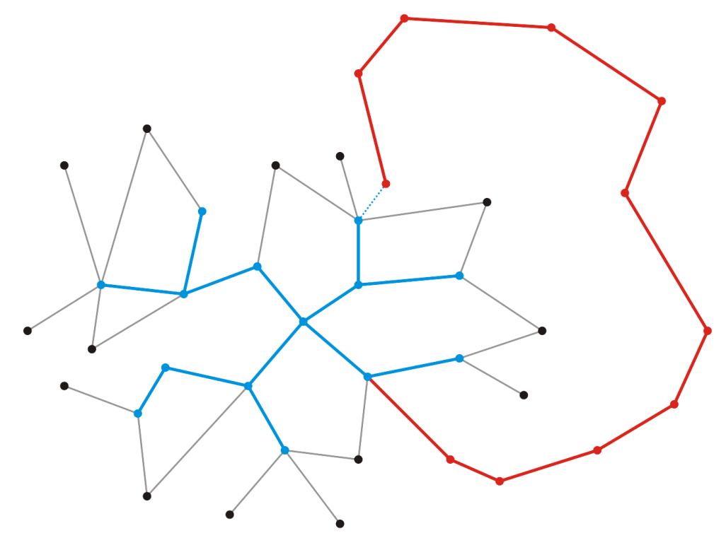
Motivation for Prim’s algorithm
Proof: Let w be the weight of this minimum spanning tree
Recall, however, that when we chose to add v_{k + 1}, it was because e_{k} was the edge connecting an adjacent vertex with least weight
Therefore where |e| represents the weight of the edge e
v_{k + 1}
e_{k}

Slide 25
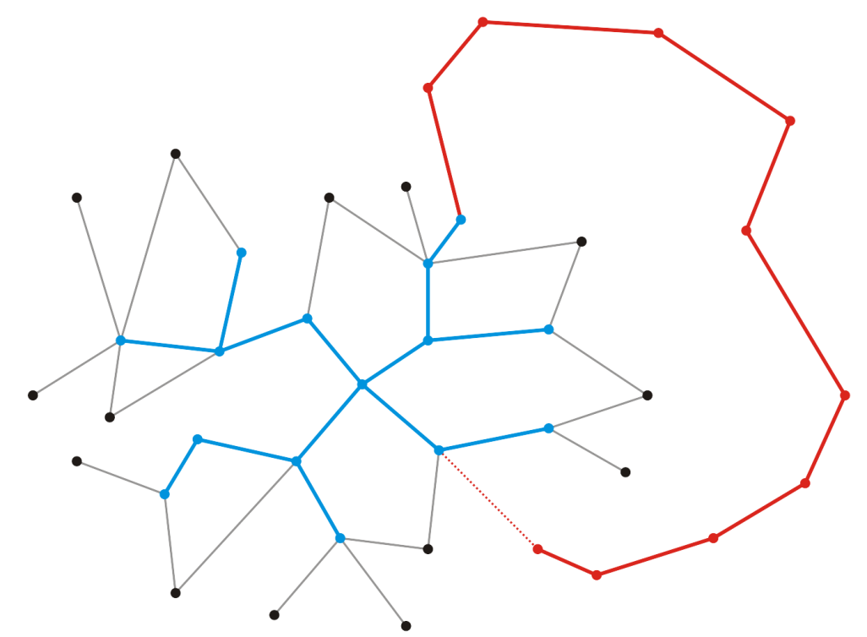
Motivation for Prim’s algorithm
Proof: Consider, however, suppose we swap edges and instead choose to include e_{k} and exclude
The result is still a minimum spanning tree, but the weight is now
v_{k + 1}
e_{k + 1}

Slide 26
Motivation for Prim’s algorithm
Proof: Thus, by swapping e_{k} for , we have a spanning tree that has less weight than the so-called minimum spanning tree containing
This contradicts our assumption that the spanning tree containing was minimal
Therefore, our minimum spanning tree must contain e_{k}
v_{k + 1}
e_{k}

Slide 27
Strategy
Recall that we did not prescribe the value of k, and thus, k could be any value, including k = 1
v_{k + 1}
e_{k}

Slide 28
Prim’s Algorithm
Associate with each vertex three items of data:
A Boolean flag indicating if the vertex has been visited,
The minimum distance to the partially constructed tree, and
A pointer to that vertex which will form the parent node in the resulting tree

Slide 29
Prim’s Algorithm
Initialization:
Select a root node and set its distance as 0
Set the distance to all other vertices as ∞
Set all vertices to being unvisited
Set the parent pointer of all vertices to 0
Iterate while there exists an unvisited vertex with distance < ∞
Select that unvisited vertex with minimum distance
Mark that vertex as having been visited
For each adjacent vertex, if the weight of the connecting edge is less than the current distance to that vertex:
Update the distance to equal the weight of the edge
Set the current vertex as the parent of the adjacent vertex

Slide 30
Prim’s Algorithm
Stopping Conditions:
There are no unvisited vertices which have a distance < ∞
If all vertices have been visited, we have a spanning tree of the entire graph
If there are vertices with distance ∞, then the graph is not connected and we only have a minimum spanning tree of the connected sub-graph containing the root

Slide 31
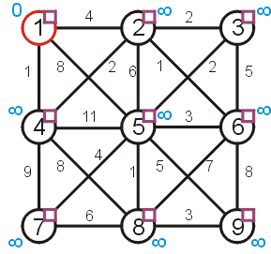
Prim’s Algorithm
Let us find the minimum spanning tree for the following undirected weighted graph.
First we set up the appropriate table and initialize it
 |  | Distance | Parent
1 | F | 0 | 0
2 | F | ∞ | 0
3 | F | ∞ | 0
4 | F | ∞ | 0
5 | F | ∞ | 0
6 | F | ∞ | 0
7 | F | ∞ | 0
8 | F | ∞ | 0
9 | F | ∞ | 0

Slide 32
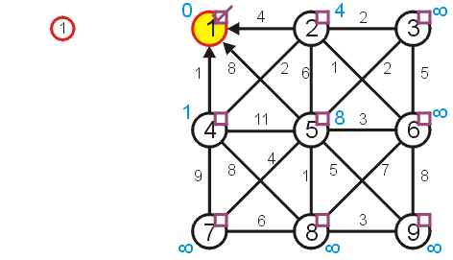
Prim’s Algorithm
Visiting vertex 1, we update vertices 2, 4, and 5
 |  | Distance | Parent
1 | T | 0 | 0
2 | F | 4 | 1
3 | F | ∞ | 0
4 | F | 1 | 1
5 | F | 8 | 1
6 | F | ∞ | 0
7 | F | ∞ | 0
8 | F | ∞ | 0
9 | F | ∞ | 0

Slide 33
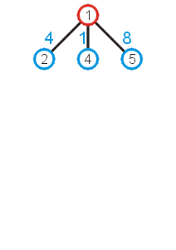
Prim’s Algorithm
What these numbers really mean is that at this point, we could extend the trivial tree containing just the root node by one of the three possible children:
As we wish to find a minimum spanning tree, it makes sense we add that vertex with a connecting edge with least weight

Slide 34
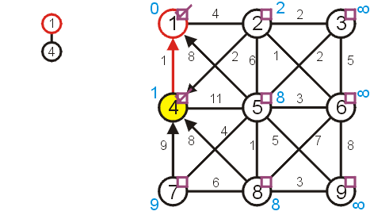
Prim’s Algorithm
The next unvisited vertex with minimum distance is vertex 4
Update vertices 2, 7, 8
Don’t update vertex 5
 |  | Distance | Parent
1 | T | 0 | 0
2 | F | 2 | 4
3 | F | ∞ | 0
4 | T | 1 | 1
5 | F | 8 | 1
6 | F | ∞ | 0
7 | F | 9 | 4
8 | F | 8 | 4
9 | F | ∞ | 0

Slide 35
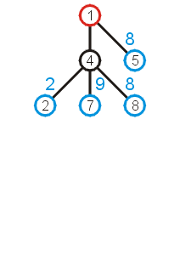
Prim’s Algorithm
Now that we have updated all vertices adjacent to vertex 4, we can extend the tree by adding one of the edges
(1, 5), (4, 2), (4, 7), or (4, 8)
We add that edge with the least weight: (4, 2)

Slide 36
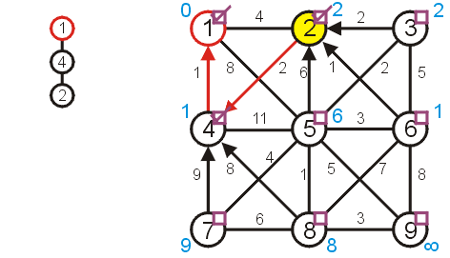
Prim’s Algorithm
Next visit vertex 2
Update 3, 5, and 6
 |  | Distance | Parent
1 | T | 0 | 0
2 | T | 2 | 4
3 | F | 2 | 2
4 | T | 1 | 1
5 | F | 6 | 2
6 | F | 1 | 2
7 | F | 9 | 4
8 | F | 8 | 4
9 | F | ∞ | 0

Slide 37
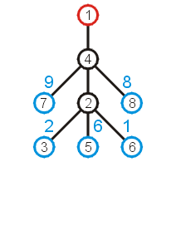
Prim’s Algorithm
Again looking at the shortest edges to each of the vertices adjacent to the current tree, we note that we can add (2, 6) with the least increase in weight

Slide 38
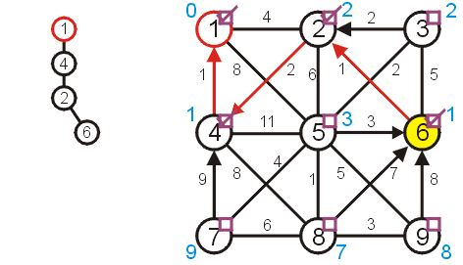
Prim’s Algorithm
Next, we visit vertex 6:
update vertices 5, 8, and 9
 |  | Distance | Parent
1 | T | 0 | 0
2 | T | 2 | 4
3 | F | 2 | 2
4 | T | 1 | 1
5 | F | 3 | 6
6 | T | 1 | 2
7 | F | 9 | 4
8 | F | 7 | 6
9 | F | 8 | 6

Slide 39
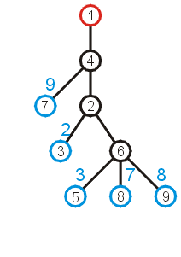
Prim’s Algorithm
The edge with least weight is (2, 3)
This adds the weight of 2 to the weight minimum spanning tree

Slide 40
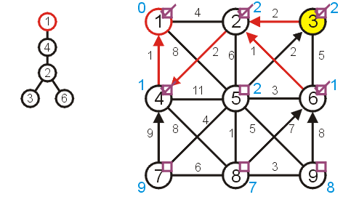
Prim’s Algorithm
Next, we visit vertex 3 and update 5
 |  | Distance | Parent
1 | T | 0 | 0
2 | T | 2 | 4
3 | T | 2 | 2
4 | T | 1 | 1
5 | F | 2 | 3
6 | T | 1 | 2
7 | F | 9 | 4
8 | F | 7 | 6
9 | F | 8 | 6

Slide 41
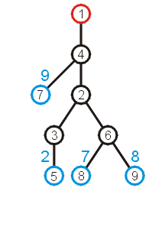
Prim’s Algorithm
At this point, we can extend the tree by adding the edge (3, 5)

Slide 42
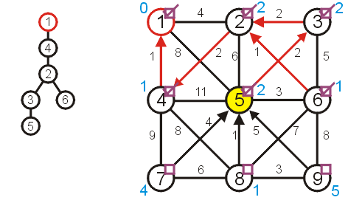
Prim’s Algorithm
Visiting vertex 5, we update 7, 8, 9
 |  | Distance | Parent
1 | T | 0 | 0
2 | T | 2 | 4
3 | T | 2 | 2
4 | T | 1 | 1
5 | T | 2 | 3
6 | T | 1 | 2
7 | F | 4 | 5
8 | F | 1 | 5
9 | F | 5 | 5

Slide 43
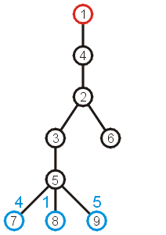
Prim’s Algorithm
At this point, there are three possible edges which we could include which will extend the tree
The edge to 8 has the least weight

Slide 44
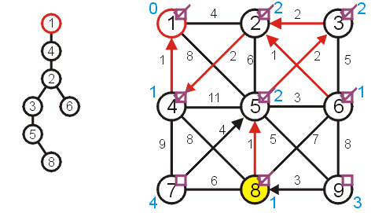
Prim’s Algorithm
Visiting vertex 8, we only update vertex 9
 |  | Distance | Parent
1 | T | 0 | 0
2 | T | 2 | 4
3 | T | 2 | 2
4 | T | 1 | 1
5 | T | 2 | 3
6 | T | 1 | 2
7 | F | 4 | 5
8 | T | 1 | 5
9 | F | 3 | 8

Slide 45
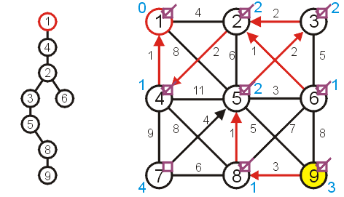
Prim’s Algorithm
There are no other vertices to update while visiting vertex 9
 |  | Distance | Parent
1 | T | 0 | 0
2 | T | 2 | 4
3 | T | 2 | 2
4 | T | 1 | 1
5 | T | 2 | 3
6 | T | 1 | 2
7 | F | 4 | 5
8 | T | 1 | 5
9 | T | 3 | 8

Slide 46
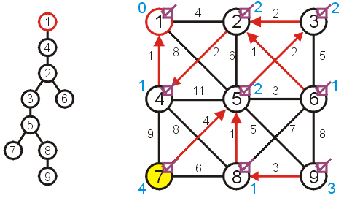
Prim’s Algorithm
And neither are there any vertices to update when visiting vertex 7
 |  | Distance | Parent
1 | T | 0 | 0
2 | T | 2 | 4
3 | T | 2 | 2
4 | T | 1 | 1
5 | T | 2 | 3
6 | T | 1 | 2
7 | T | 4 | 5
8 | T | 1 | 5
9 | T | 3 | 8

Slide 47
Prim’s Algorithm
At this point, there are no more unvisited vertices, and therefore we are done
If at any point, all remaining vertices had a distance of ∞, this would indicate that the graph is not connected
in this case, the minimum spanning tree would only span one connected sub-graph

Slide 48
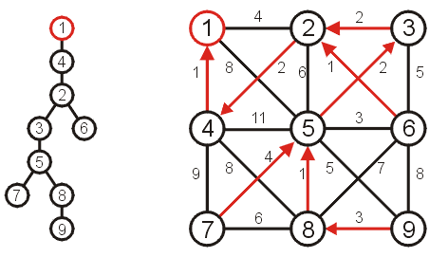
Prim’s Algorithm
Using the parent pointers, we can now construct the minimum spanning tree
 |  | Distance | Parent
1 | T | 0 | 0
2 | T | 2 | 4
3 | T | 2 | 2
4 | T | 1 | 1
5 | T | 2 | 3
6 | T | 1 | 2
7 | T | 4 | 5
8 | T | 1 | 5
9 | T | 3 | 8

Slide 49
Prim’s Algorithm
To summarize:
we begin with a vertex which represents the root
starting with this trivial tree and iteration, we find the shortest edge which we can add to this already existing tree to expand it
This is a reasonably efficient algorithm: the number of visits to vertices is kept to a minimum

Slide 50
Implementation and analysis
The initialization requires Ο(|V|) memory and run time
We iterate |V| – 1 times, each time finding the closest vertex
Iterating through the table requires is Ο(|V|) time
Each time we find a vertex, we must check all of its neighbors
With an adjacency matrix, the run time is Ο(|V|(|V| + |V|)) = Ο(|V|²)
With an adjacency list, the run time is Ο(|V|² + |E|) = Ο(|V|²) as |E| = O(|V|²)
Can we do better?
Recall, we only need the vertex with the shortest distance next
How about a min heap?

Slide 51
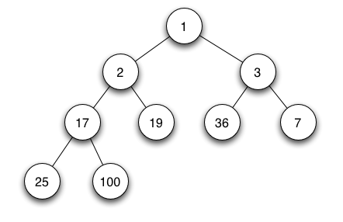
Min-heap-based optimization
a min heap
The initialization still requires Ο(|V|) memory and run time
The min heap will also require Ο(|V|) memory which contains the distance of all the vertices
We iterate |V| – 1 times, each time finding the closest vertex
Obtain the shortest distance from the min heap O(1), maintain the heap O(log(|V|))
Thus, the work required for this is O(|V| log(|V|))
Is this all the work that is necessary?
Recall that for the closest vertex in an iteration, we try to update the distance of all its neighbors, thus there are O(|E|) updates in total and each update in the heap requires O(log(|V|)).
Thus, the work required for this is O(|E| log(|V|))
Thus, the total run time is O(|V| log(|V|) + |E| log(|V|)) = O(|E| log(|V|))
Notes:
O(|E|) updates in total
→
O(\sum deg) = O(|E|) updates in total

Slide 52
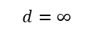
Min-heap-based optimization
 |  | Distance | Parent
1 | F | 0 | 0
2 | F | ∞ | 0
3 | F | ∞ | 0
4 | F | ∞ | 0
5 | F | ∞ | 0
6 | F | ∞ | 0
7 | F | ∞ | 0
8 | F | ∞ | 0
9 | F | ∞ | 0
1
$$d=0$$
2
3
$$d=∞$$
$$d=∞$$
4
5
6
7
$$d=∞$$
$$d=∞$$
$$d=∞$$
$$d=∞$$
8
9
$$d=∞$$
$$d=∞$$

Slide 53
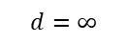
Min-heap-based optimization
 |  | Distance | Parent
1 | T | 0 | 0
2 | F | 4 | 1
3 | F | ∞ | 0
4 | F | 1 | 1
5 | F | 8 | 1
6 | F | ∞ | 0
7 | F | ∞ | 0
8 | F | ∞ | 0
9 | F | ∞ | 0
4
$$d=1$$
2
3
$$d=∞$$
$$d=4$$
9
5
6
7
$$d=8$$
$$d=∞$$
$$d=∞$$
$$d=∞$$
8
$$d=∞$$
Visiting vertex 1, we update vertices 2, 4, and 5

Slide 54
Kruskal’s Algorithm

Slide 55
Kruskal’s Algorithm
Kruskal’s algorithm sorts the edges by weight and goes through the edges from least weight to greatest weight adding the edges to an empty graph so long as the addition does not create a cycle
The halting point is:
When |V| – 1 edges have been added
In this case we have a minimum spanning tree
We have gone through all edges, in which case, we have a forest of minimum spanning trees on all connected sub-graphs

Slide 56
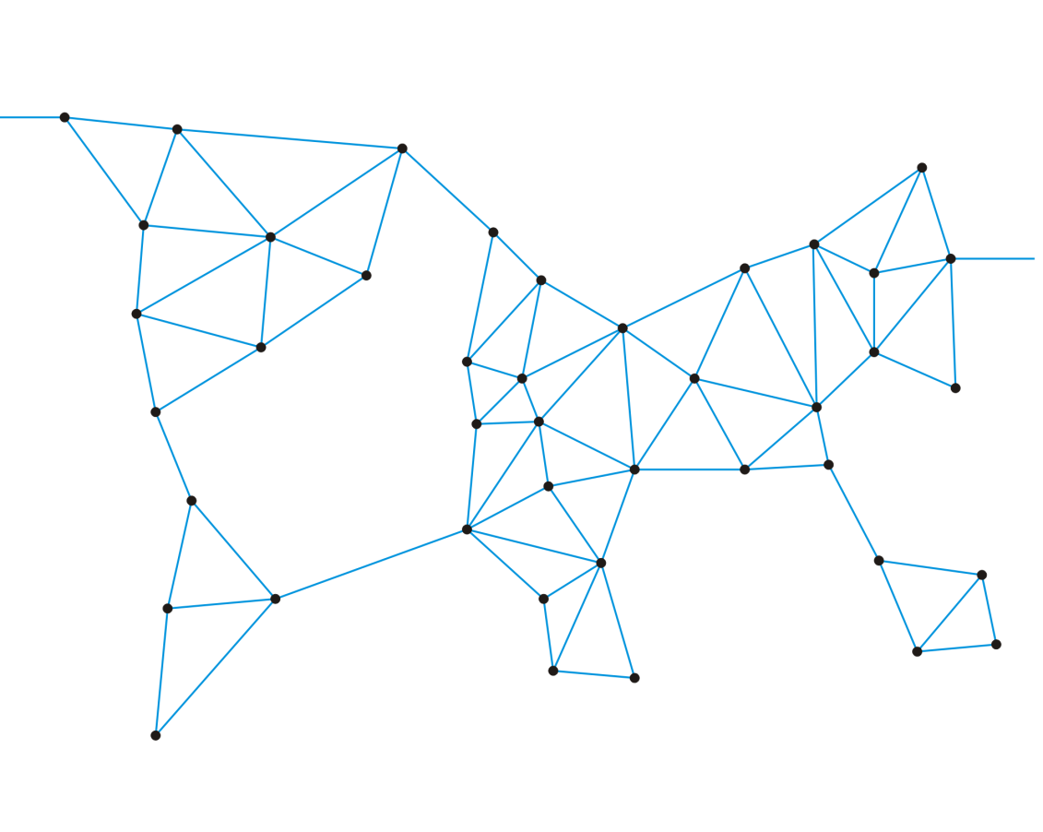
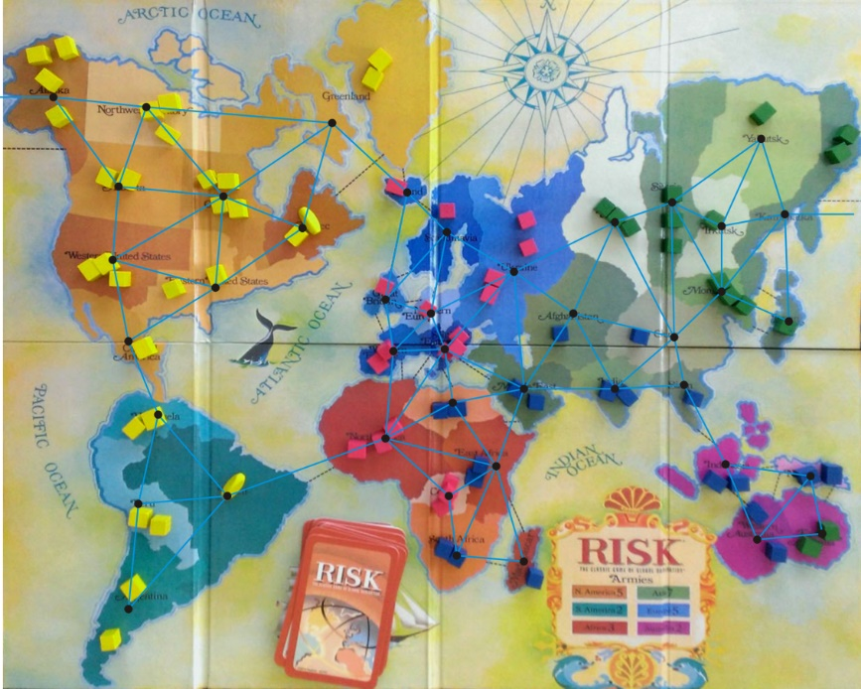
Example
Consider the game of Risk from Parker Brothers
A game of world domination
The world is divided into 42 connected regions
The regions are vertices and edges indicate adjacent regions
http://thunderbird37.com/tag/parker-brothers/

Slide 57
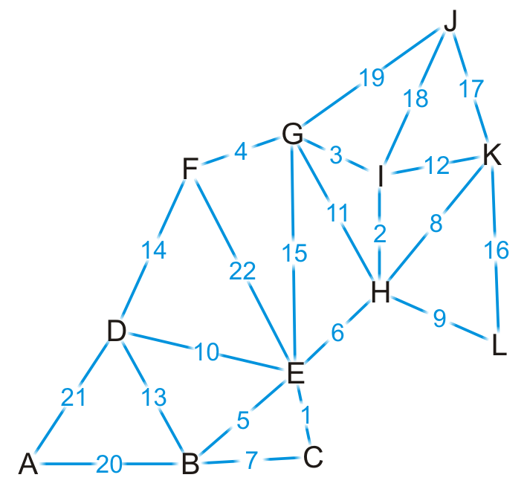
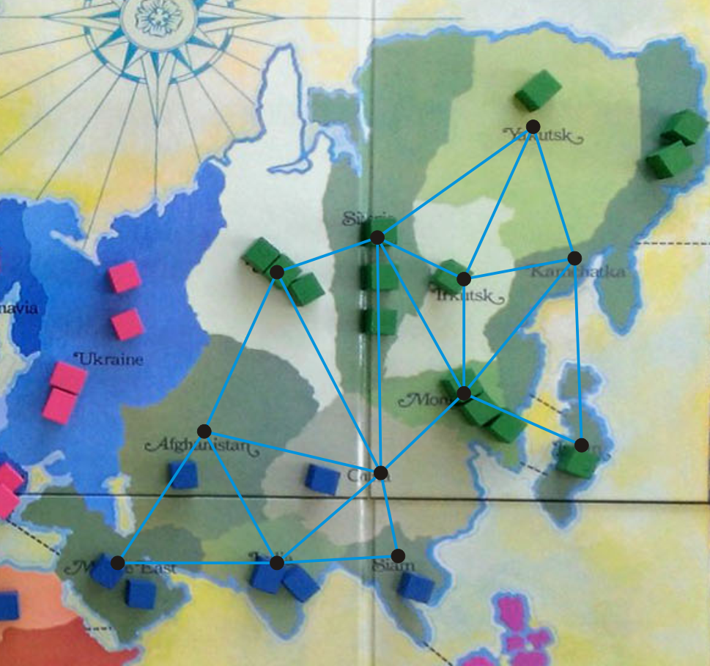
Example
{C, E}
{H, I}
{G, I}
{F, G}
{B, E}
{E, H}
{B, C}
{H, K}
{H, L}
{D, E}
{G, H}
{I, K}
{B, D}
{D, F}
{E, G}
{K, L}
{J, K}
{J, I}
{J, G}
{A, B}
{A, D}
{E, F}
Here is our abstract representation of Asia. Let us give a weight to each of the edges. First, we sort the edges based on weight.

Slide 58

Example
{C, E}
{H, I}
{G, I}
{F, G}
{B, E}
{E, H}
{B, C}
{H, K}
{H, L}
{D, E}
{G, H}
{I, K}
{B, D}
{D, F}
{E, G}
{K, L}
{J, K}
{J, I}
{J, G}
{A, B}
{A, D}
{E, F}
We start by adding edge {C, E}

Slide 59
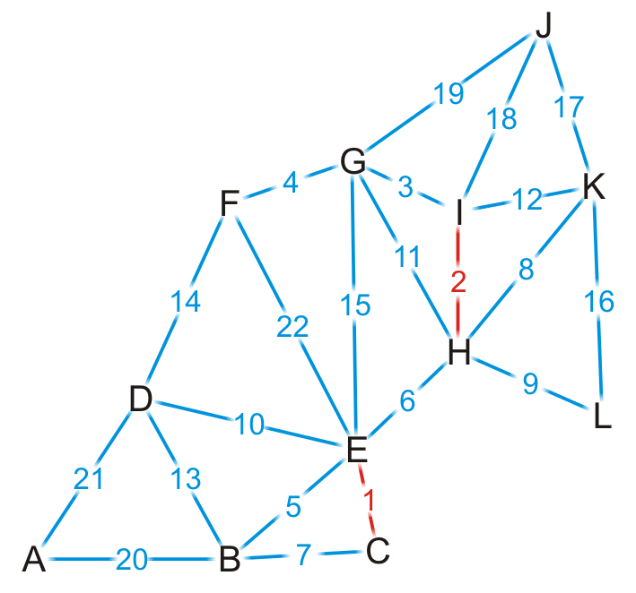
Example
{C, E}
{H, I}
{G, I}
{F, G}
{B, E}
{E, H}
{B, C}
{H, K}
{H, L}
{D, E}
{G, H}
{I, K}
{B, D}
{D, F}
{E, G}
{K, L}
{J, K}
{J, I}
{J, G}
{A, B}
{A, D}
{E, F}
We add edge {H, I}

Slide 60
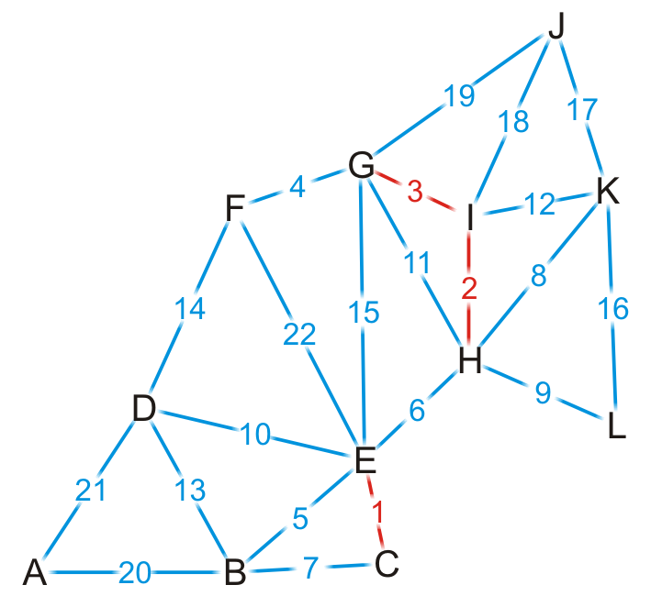
Example
{C, E}
{H, I}
{G, I}
{F, G}
{B, E}
{E, H}
{B, C}
{H, K}
{H, L}
{D, E}
{G, H}
{I, K}
{B, D}
{D, F}
{E, G}
{K, L}
{J, K}
{J, I}
{J, G}
{A, B}
{A, D}
{E, F}
We add edge {G, I}

Slide 61

Example
{C, E}
{H, I}
{G, I}
{F, G}
{B, E}
{E, H}
{B, C}
{H, K}
{H, L}
{D, E}
{G, H}
{I, K}
{B, D}
{D, F}
{E, G}
{K, L}
{J, K}
{J, I}
{J, G}
{A, B}
{A, D}
{E, F}
We add edge {F, G}

Slide 62
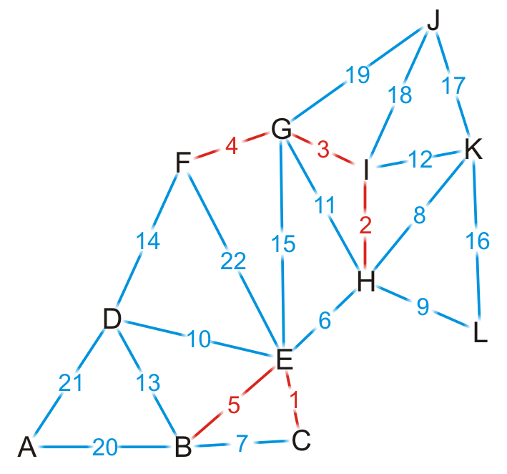
Example
{C, E}
{H, I}
{G, I}
{F, G}
{B, E}
{E, H}
{B, C}
{H, K}
{H, L}
{D, E}
{G, H}
{I, K}
{B, D}
{D, F}
{E, G}
{K, L}
{J, K}
{J, I}
{J, G}
{A, B}
{A, D}
{E, F}
We add edge {B, E}

Slide 63
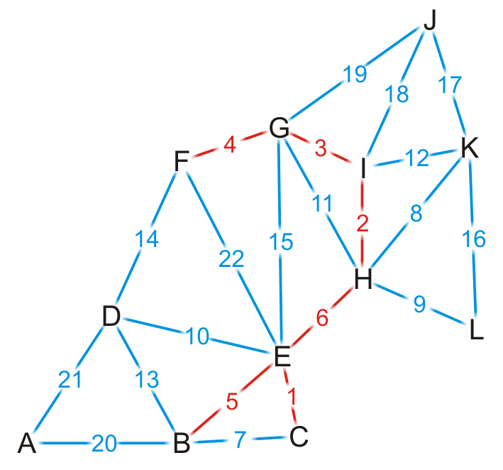
Example
{C, E}
{H, I}
{G, I}
{F, G}
{B, E}
{E, H}
{B, C}
{H, K}
{H, L}
{D, E}
{G, H}
{I, K}
{B, D}
{D, F}
{E, G}
{K, L}
{J, K}
{J, I}
{J, G}
{A, B}
{A, D}
{E, F}
We add edge {E, H}
This coalesces the two spanning sub-trees into one

Slide 64

Example
{C, E}
{H, I}
{G, I}
{F, G}
{B, E}
{E, H}
{B, C}
{H, K}
{H, L}
{D, E}
{G, H}
{I, K}
{B, D}
{D, F}
{E, G}
{K, L}
{J, K}
{J, I}
{J, G}
{A, B}
{A, D}
{E, F}
We try adding {B, C}, but it creates a cycle

Slide 65

Example
{C, E}
{H, I}
{G, I}
{F, G}
{B, E}
{E, H}
{B, C}
{H, K}
{H, L}
{D, E}
{G, H}
{I, K}
{B, D}
{D, F}
{E, G}
{K, L}
{J, K}
{J, I}
{J, G}
{A, B}
{A, D}
{E, F}
We add edge {H, K}

Slide 66

Example
{C, E}
{H, I}
{G, I}
{F, G}
{B, E}
{E, H}
{B, C}
{H, K}
{H, L}
{D, E}
{G, H}
{I, K}
{B, D}
{D, F}
{E, G}
{K, L}
{J, K}
{J, I}
{J, G}
{A, B}
{A, D}
{E, F}
We add edge {H, L}

Slide 67

Example
{C, E}
{H, I}
{G, I}
{F, G}
{B, E}
{E, H}
{B, C}
{H, K}
{H, L}
{D, E}
{G, H}
{I, K}
{B, D}
{D, F}
{E, G}
{K, L}
{J, K}
{J, I}
{J, G}
{A, B}
{A, D}
{E, F}
We add edge {D, E}

Slide 68

Example
{C, E}
{H, I}
{G, I}
{F, G}
{B, E}
{E, H}
{B, C}
{H, K}
{H, L}
{D, E}
{G, H}
{I, K}
{B, D}
{D, F}
{E, G}
{K, L}
{J, K}
{J, I}
{J, G}
{A, B}
{A, D}
{E, F}
We try adding {G, H}, but it creates a cycle

Slide 69

Example
{C, E}
{H, I}
{G, I}
{F, G}
{B, E}
{E, H}
{B, C}
{H, K}
{H, L}
{D, E}
{G, H}
{I, K}
{B, D}
{D, F}
{E, G}
{K, L}
{J, K}
{J, I}
{J, G}
{A, B}
{A, D}
{E, F}
We try adding {I, K}, but it creates a cycle

Slide 70

Example
{C, E}
{H, I}
{G, I}
{F, G}
{B, E}
{E, H}
{B, C}
{H, K}
{H, L}
{D, E}
{G, H}
{I, K}
{B, D}
{D, F}
{E, G}
{K, L}
{J, K}
{J, I}
{J, G}
{A, B}
{A, D}
{E, F}
We try adding {B, D}, but it creates a cycle

Slide 71

Example
{C, E}
{H, I}
{G, I}
{F, G}
{B, E}
{E, H}
{B, C}
{H, K}
{H, L}
{D, E}
{G, H}
{I, K}
{B, D}
{D, F}
{E, G}
{K, L}
{J, K}
{J, I}
{J, G}
{A, B}
{A, D}
{E, F}
We try adding {D, F}, but it creates a cycle

Slide 72

Example
{C, E}
{H, I}
{G, I}
{F, G}
{B, E}
{E, H}
{B, C}
{H, K}
{H, L}
{D, E}
{G, H}
{I, K}
{B, D}
{D, F}
{E, G}
{K, L}
{J, K}
{J, I}
{J, G}
{A, B}
{A, D}
{E, F}
We try adding {E, G}, but it creates a cycle

Slide 73

Example
{C, E}
{H, I}
{G, I}
{F, G}
{B, E}
{E, H}
{B, C}
{H, K}
{H, L}
{D, E}
{G, H}
{I, K}
{B, D}
{D, F}
{E, G}
{K, L}
{J, K}
{J, I}
{J, G}
{A, B}
{A, D}
{E, F}
By observation, we can still add edges {J, K} and {A, B}

Slide 74
Example
{C, E}
{H, I}
{G, I}
{F, G}
{B, E}
{E, H}
{B, C}
{H, K}
{H, L}
{D, E}
{G, H}
{I, K}
{B, D}
{D, F}
{E, G}
{K, L}
{J, K}
{J, I}
{J, G}
{A, B}
{A, D}
{E, F}
Having added {A, B}, we now have 11 edges
We terminate the loop
We have our minimum spanning tree

Slide 75
Analysis
Implementation
We would store the edges and their weights in an array
We would sort the edges using either quicksort or some distribution sort
To determine if a cycle is created, we could perform a BFS traversal
A run-time of Ο(|V|)
Consequently, the run-time would be Ο(|E| log(|E|) + |E|·|V|)
However, |E| = O(|V|²), so log(E) = O(log(|V|²)) = O(2 log(|V|)) = O(log(|V|))
Consequently, the run-time would be Ο(|E| log(|E|) + |E||V|) = Ο(|E|·|V|)
The critical operation is determining if two vertices are connected
Notes:
Using traversal to determine connectedness is too expensive.
Using a disjoint set data structure is handy in this situation.

Slide 76
Analysis
Instead, we could use disjoint sets
Consider edges in the same connected sub-graph as forming a set
If the vertices of the next edge are in different sets, take the union of the two sets
Do not add an edge if both vertices are in the same set
Add edge (E, H)?
{B, C, E, F, G, H, I}
{B, C, E}, {F, G, H, I}

Slide 77
Analysis
The disjoint set data structure has the following average run-times:
Checking if two vertices are in the same set is almost linear
Taking the union of two disjoint sets is almost linear
Thus, checking and building the minimum spanning tree is now Ο(|E|)
The dominant time is now the time required to sort the edges:
Using quicksort, the run-time is Ο(|E| log(|E|))

Slide 78


Example
{C, E}
{H, I}
{G, I}
{F, G}
{B, E}
{E, H}
{B, C}
{H, K}
{H, L}
{D, E}
{G, H}
{I, K}
{B, D}
{D, F}
{E, G}
{K, L}
{J, K}
{J, I}
{J, G}
{A, B}
{A, D}
{E, F}
Going through the example again with disjoint sets. We start with twelve singletons
{A}, {B}, {C}, {D}, {E}, {F}, {G}, {H}, {I}, {J}, {K}, {L}
Initialization:
For each vertex $u_{i} ∈[A,L]$, each vertex direct to themselves.
$$u_{i}$$
Notes:
Initialization: all nodes direct to themselves. In the following slides, we only show the tree whose depth is larger than 1.

Slide 79


Example
{C, E}
{H, I}
{G, I}
{F, G}
{B, E}
{E, H}
{B, C}
{H, K}
{H, L}
{D, E}
{G, H}
{I, K}
{B, D}
{D, F}
{E, G}
{K, L}
{J, K}
{J, I}
{J, G}
{A, B}
{A, D}
{E, F}
We start by adding edge {C, E}
{A}, {B}, {C, E}, {D}, {F}, {G}, {H}, {I}, {J}, {K}, {L}
$$C$$
E
$$C$$
E

Slide 80



Example
{C, E}
{H, I}
{G, I}
{F, G}
{B, E}
{E, H}
{B, C}
{H, K}
{H, L}
{D, E}
{G, H}
{I, K}
{B, D}
{D, F}
{E, G}
{K, L}
{J, K}
{J, I}
{J, G}
{A, B}
{A, D}
{E, F}
We add edge {H, I}
{A}, {B}, {C, E}, {D}, {F}, {G}, {H, I}, {J}, {K}, {L}
$$C$$
$$H$$
I
E
$$C$$
$$H$$
E
I

Slide 81







Example
{C, E}
{H, I}
{G, I}
{F, G}
{B, E}
{E, H}
{B, C}
{H, K}
{H, L}
{D, E}
{G, H}
{I, K}
{B, D}
{D, F}
{E, G}
{K, L}
{J, K}
{J, I}
{J, G}
{A, B}
{A, D}
{E, F}
{A}, {B, C, E}, {D}, {F, G, H, I}, {J}, {K}, {L}
Similarly, we add {G, I}, {F, G}, {B, E}
Add {G,I}: According to the rule of Union by Size, make smaller tree point to bigger one’s root.
$$H$$
$$H$$
G
I
G
I
Add {F,G}:
$$H$$
$$H$$
F
G
I
F
G
I
Add {B,E} (Union by Size):
$$C$$
$$C$$
$$B$$
E
$$B$$
E

Slide 82




Example
{C, E}
{H, I}
{G, I}
{F, G}
{B, E}
{E, H}
{B, C}
{H, K}
{H, L}
{D, E}
{G, H}
{I, K}
{B, D}
{D, F}
{E, G}
{K, L}
{J, K}
{J, I}
{J, G}
{A, B}
{A, D}
{E, F}
The vertices of {E, H} are in different sets
{A}, {B, C, E}, {D}, {F, G, H, I}, {J}, {K}, {L}
Merge these two trees:
$$H$$
$$C$$
F
G
I
B
E
Make smaller tree point to bigger one’s root (C points to H).
$$H$$
F
G
I
$$C$$
B
E

Slide 83




Example
{C, E}
{H, I}
{G, I}
{F, G}
{B, E}
{E, H}
{B, C}
{H, K}
{H, L}
{D, E}
{G, H}
{I, K}
{B, D}
{D, F}
{E, G}
{K, L}
{J, K}
{J, I}
{J, G}
{A, B}
{A, D}
{E, F}
We try adding {B, C}, but it creates a cycle.
{A}, {B, C, E, F, G, H, I}, {D}, {J}, {K}, {L}
$$H$$
F
G
I
$$C$$
B
E
According to the rule of Path Compression, while finding B, direct B to the root H. Because C is already point to root, the position of C would not change.
$$H$$
F
G
I
C
B
E

Slide 84



Example
{C, E}
{H, I}
{G, I}
{F, G}
{B, E}
{E, H}
{B, C}
{H, K}
{H, L}
{D, E}
{G, H}
{I, K}
{B, D}
{D, F}
{E, G}
{K, L}
{J, K}
{J, I}
{J, G}
{A, B}
{A, D}
{E, F}
{A}, {B, C, E, F, G, H, I, K, L}, {D}, {J}
We add edge {H, K}, {H, L}
Add edge {H, K}, {H, L}:
$$H$$
F
G
I
C
B
E
$$H$$
L
K
F
G
I
C
B
E

Slide 85


Example
{C, E}
{H, I}
{G, I}
{F, G}
{B, E}
{E, H}
{B, C}
{H, K}
{H, L}
{D, E}
{G, H}
{I, K}
{B, D}
{D, F}
{E, G}
{K, L}
{J, K}
{J, I}
{J, G}
{A, B}
{A, D}
{E, F}
{A}, {B, C, D, E, F, G, H, I, K, L}, {J}
We add edge {D, E}
Add edge {D, E}:
$$H$$
L
K
F
G
I
C
B
E
While adding D, according to the rule of Union by Size, make smaller tree D point to the bigger one’s root H.
While finding E, according to the rule of Path Compression, direct E to the root H.
$$H$$
L
K
F
G
I
C
B
E
D

Slide 86


Example
{C, E}
{H, I}
{G, I}
{F, G}
{B, E}
{E, H}
{B, C}
{H, K}
{H, L}
{D, E}
{G, H}
{I, K}
{B, D}
{D, F}
{E, G}
{K, L}
{J, K}
{J, I}
{J, G}
{A, B}
{A, D}
{E, F}
Both G and H are in the same set
{A}, {B, C, D, E, F, G, H, I, K, L}, {J}
$$H$$
L
K
F
G
I
C
B
E
D

Slide 87


Example
{C, E}
{H, I}
{G, I}
{F, G}
{B, E}
{E, H}
{B, C}
{H, K}
{H, L}
{D, E}
{G, H}
{I, K}
{B, D}
{D, F}
{E, G}
{K, L}
{J, K}
{J, I}
{J, G}
{A, B}
{A, D}
{E, F}
Both {I, K} are in the same set
{A}, {B, C, D, E, F, G, H, I, K, L}, {J}
$$H$$
L
K
F
G
I
C
B
E
D

Slide 88


Example
{C, E}
{H, I}
{G, I}
{F, G}
{B, E}
{E, H}
{B, C}
{H, K}
{H, L}
{D, E}
{G, H}
{I, K}
{B, D}
{D, F}
{E, G}
{K, L}
{J, K}
{J, I}
{J, G}
{A, B}
{A, D}
{E, F}
Both {B, D} are in the same set
{A}, {B, C, D, E, F, G, H, I, K, L}, {J}
$$H$$
L
K
F
G
I
C
B
E
D

Slide 89


Example
{C, E}
{H, I}
{G, I}
{F, G}
{B, E}
{E, H}
{B, C}
{H, K}
{H, L}
{D, E}
{G, H}
{I, K}
{B, D}
{D, F}
{E, G}
{K, L}
{J, K}
{J, I}
{J, G}
{A, B}
{A, D}
{E, F}
Both {D, F} are in the same set
{A}, {B, C, D, E, F, G, H, I, K, L}, {J}
$$H$$
L
K
F
G
I
C
B
E
D

Slide 90



Example
{C, E}
{H, I}
{G, I}
{F, G}
{B, E}
{E, H}
{B, C}
{H, K}
{H, L}
{D, E}
{G, H}
{I, K}
{B, D}
{D, F}
{E, G}
{K, L}
{J, K}
{J, I}
{J, G}
{A, B}
{A, D}
{E, F}
Until adding {J,K}
{A}, {B, C, D, E, F, G, H, I, J, K, L}
$$H$$
L
K
F
G
I
C
B
E
D
$$H$$
J
L
K
F
G
I
C
B
E
D

Slide 91



Example
{C, E}
{H, I}
{G, I}
{F, G}
{B, E}
{E, H}
{B, C}
{H, K}
{H, L}
{D, E}
{G, H}
{I, K}
{B, D}
{D, F}
{E, G}
{K, L}
{J, K}
{J, I}
{J, G}
{A, B}
{A, D}
{E, F}
We end when there is only one set, having added (A, B)
{A, B, C, D, E, F, G, H, I, K, L, J}
$$H$$
J
L
K
F
G
I
C
B
E
D
$$H$$
J
L
K
F
G
I
C
D
E
B
A

Slide 92
Summary
This topic has covered Kruskal’s algorithm
Sort the edges by weight
Create a disjoint set of the vertices
Begin adding the edges one-by-one checking to ensure no cycles are introduced
The result is a minimum spanning tree
The run time is Ο(|E| log(|E|))
Notes:
Sorting : O(E log(E))
For each edge, set-union operation: O(E log(V))
On sparse graphs, O(E log(V)) is larger than O(E log(E)).

Slide 93
Learning Outcome
- Know the definition of spanning tree and minimum spanning tree
- Understand the algorithms to compute the minimum spanning tree (Prim’s algorithm, Kruskal’s algorithm with the Union-Find structure)
- Shortest path
Dijkstra’s algorithm, A* algorithm, Floyd-Warshall

